Slide 1
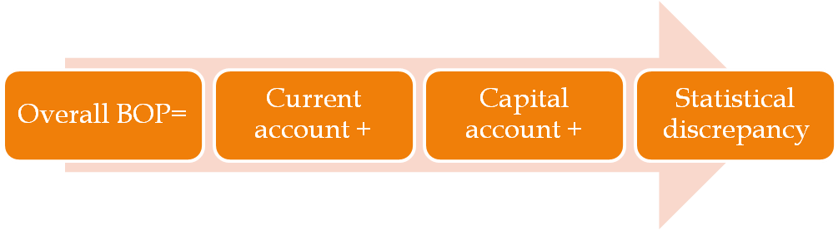
BALANCE OF PAYMENT
A systematic summary of the economic transactions of the residents of a country with the rest of the world during a specified time period, normally a year.

Slide 2
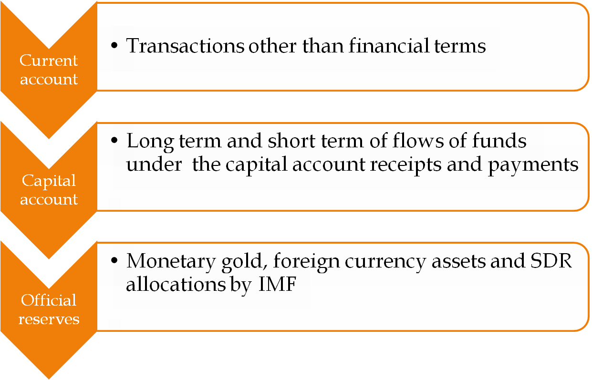
Components of BOP

Slide 3
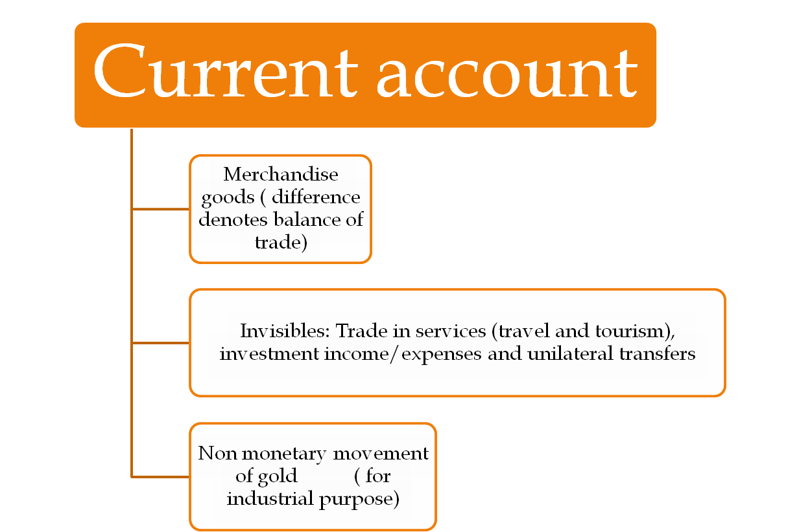

Slide 4
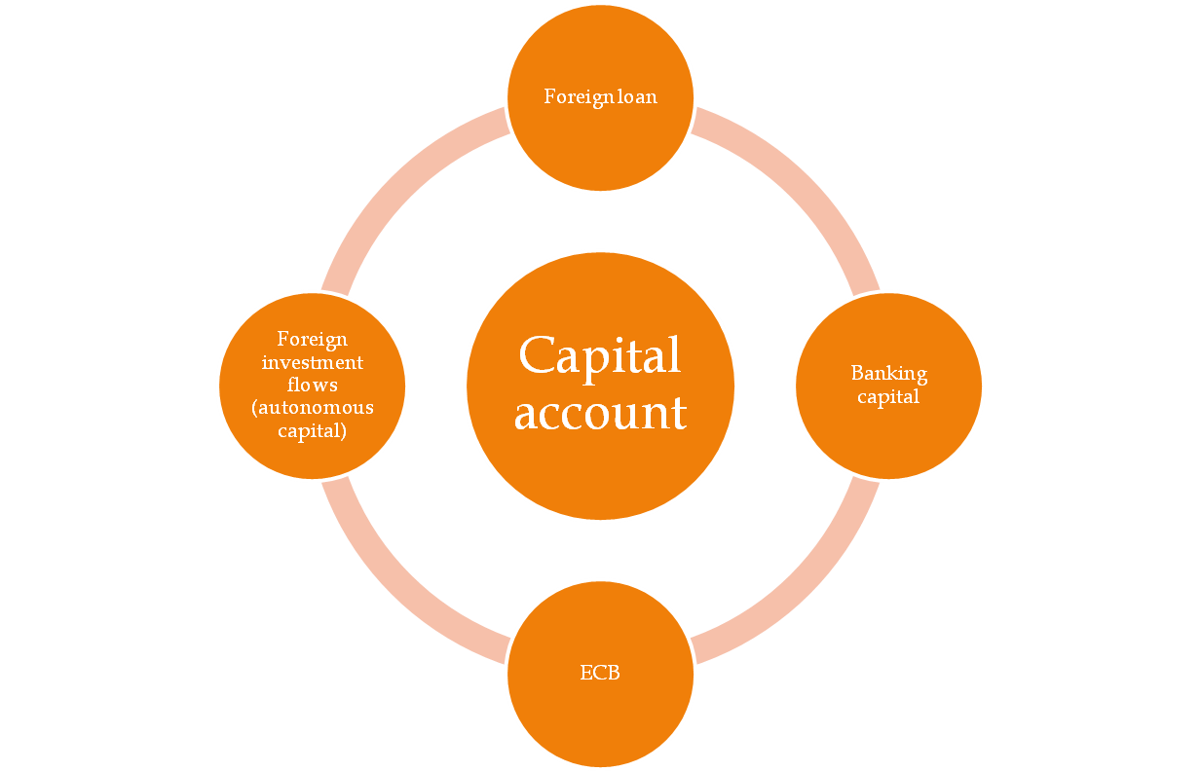
Capital account

Slide 5
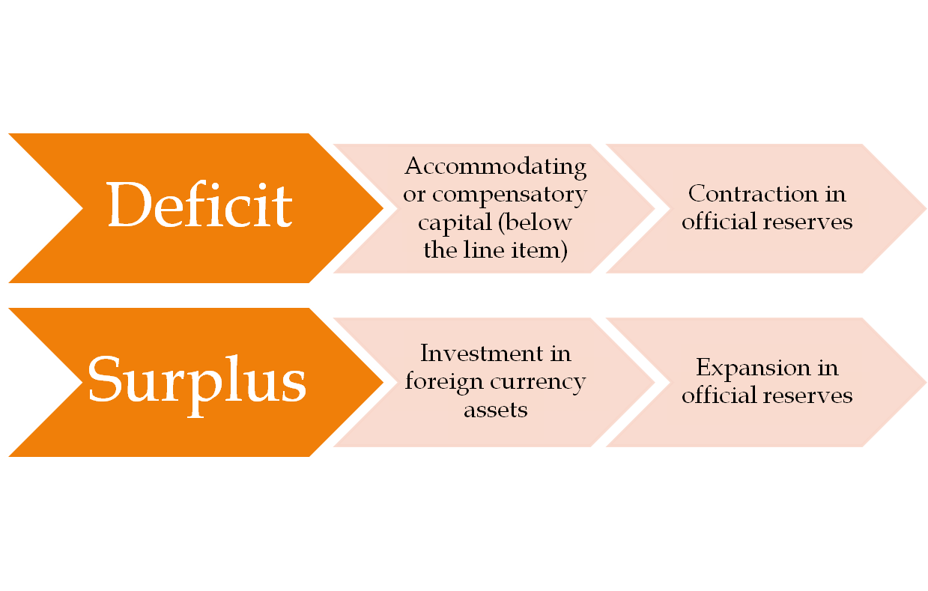
BOP balance and official reserves: Double entry principle

Slide 6
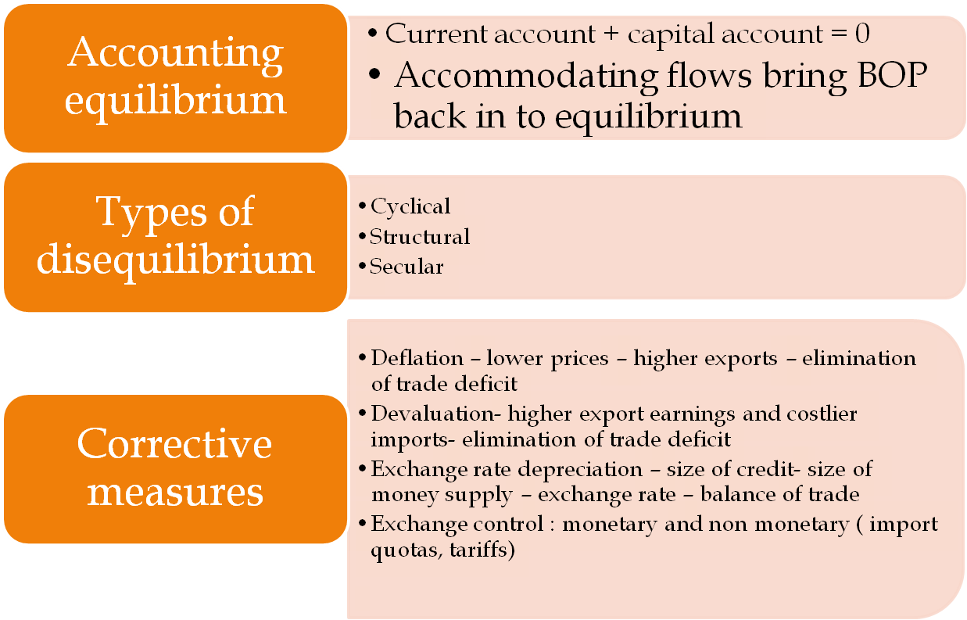
BOP Disequilibrium Adjustment

Slide 7
Exchange rate : Key concepts
Determinants
BOP
Inflation
Money supply
Interest rate
National income
Resource discovery
Capital flows
Political
Psychological
Technological
Market
Concepts
Direct quote Vs Indirect quote
American term Vs European term (respective currency per dollar)
Bid rate Vs Ask rate Spread
Cross rate – rate derived from two other rates.
Depth of the market – volume of transactions
Swap points
Floating Vs Fixed exchange rate system

Slide 8
Fixed vs Flexible rate regime
1. Fixed Exchange Rates
1. Promotion of international trade
2. Promotion of international investment
3. Facility of long-range planning
4. Development of currency areas
5. Prevention of speculation
6. Small open economies
7. Inflation
8. Terms of trade
9. Competitive exchage depreciation.

Slide 9
Flexible exchange rate
Adjustment of BOP
Better confidence
Better liquidity
Gains from free trade
Independence of policy.
Cost price relationship.
Managed float – Govt. allow the currency to fluctuate evry day basis, but intervene from currencies moving too far in certain direction.

Slide 10
Current account convertibility
Convertibility on current account is the freedom to buy or sell foreign exchange for the following international transactions.
All payments due in connection with foreign trade and other current business.
Payment due as interest on loans and as net income from other investment
Moderate remittance for family living expenses.

Slide 11
Capital account convertibility
CAC refers to a policy change that permits capital to flow more freely in and out of a country. It is the freedom to convert the local financial assets in to foreign financial assets and vice versa at market determined rate of exchange
Tarapore committee recommends three important signposts for full CAC in India –
fiscal consolidation, a mandated inflation target and strengthening of the financial system.

Slide 12
EXCHANGE CONTROL
Exchange control refers to the control, by the government or a centralized agency of transaction involving foreign exchange. In a broad sense, any stipulation or regulation which restricts the free play of forces in an exchange market can be termed exercise of exchange control.

Slide 13
Objectives of exchange control
Stability of exchange rates
Over valuation of Currency
Under valuation of currency
Balance of payment deficits:
Reserve foreign exchange for essentials of the country
Freeze foreign national assets
Economic Planning
Develop bilateralism
Encourage local industries

Slide 14
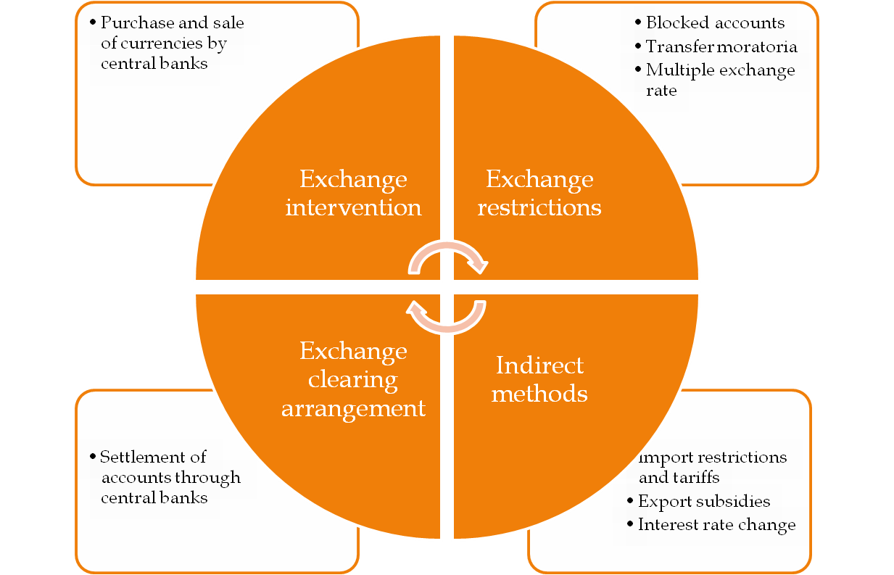
Exchange control : Tools

